Slide 1

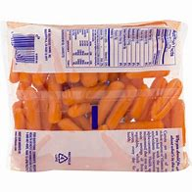
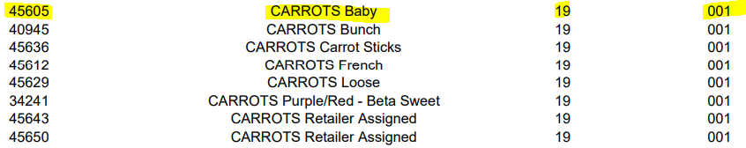

PLU Mapping
All PLUs must be mapped to the product most similar that is listed on the APL. This applies to any fresh fruit and vegetable in Category 19, Subcategory 001
Bagged/Packaged fresh fruit and vegetables with UPC’s will not scan as a WIC authorized food item
  These UPC’s must be mapped to PLUs in the APL
  Ex. You receive a shipment of Bolthouse Farms bagged baby carrots, which contains a UPC barcode. This UPC must be mapped to a PLU on the APL for baby carrots.
apl.xlsx (state.nj.us)

Slide 2
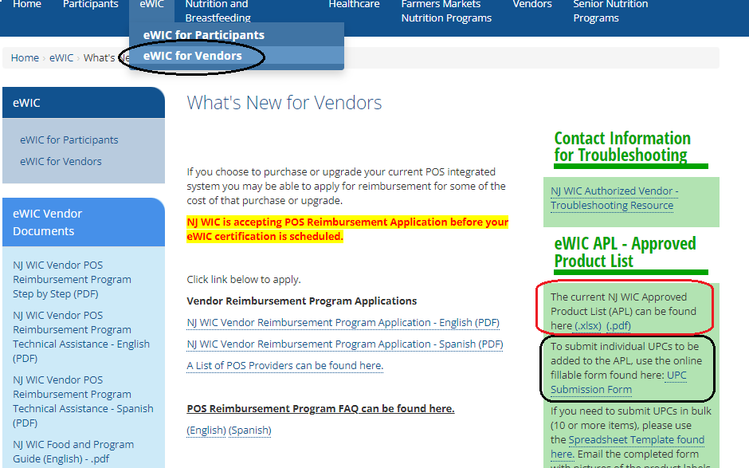
Department of Health | WIC | What's New for Vendors (state.nj.us)
The eWIC APL link is a reference for NJ WIC Vendors
Use this APL for PLU mapping of fruits and vegetables
Verify if an item is WIC approved
If you believe an item should be added to the APL, you may fill the UPC Submission Form for consideration

Slide 3
How to Prevent the Need for a Void
Review and verify the transaction log and receipt
Recommend the participant to separate WIC authorized from non-WIC authorized foods at the register (mixed basket transactions may lead to unintentional transaction errors during this learning phase of eWIC)
Ensure store personnel is trained on eWIC transaction procedures specific to your store’s POS
If store personnel have questions or concerns about eWIC transactions, please reach out to your POS provider for additional training and assistance

Slide 4
Voiding eWIC Transactions
Once eWIC transactions are completed and approved, WIC benefits cannot be returned to the eWIC account
  eWIC transactions are final
A void can only occur while a transaction is still open in progress
  Example: A participant has a mixed basket and selected a non-WIC cereal. While the transaction is still open, the cashier can select the WIC … Verify with L3 team

Slide 5
The Importance of eWIC Purchase Receipts
It is a requirement that the WIC Cardholder be provided a receipt showing details of the purchases. (Provision of the receipt is an FNS requirement and included in the NJ WIC Vendor Authorization Agreement.)
The receipt is verification that the purchase or void was completed as expected. The cashier must review the receipt to confirm accuracy of the transaction
The items the WIC cardholder is leaving the store with should always match the items listed as Purchased on the receipt
WIC Cardholders are trained at their WIC Local Agency to save their last eWIC receipt to keep track of their remaining balance. This will assist in their next shopping trip.
If ever there is a need for a dispute resolution from the Cardholder or the Vendor, the receipt is required as documentation of what error may have occurred

Slide 6
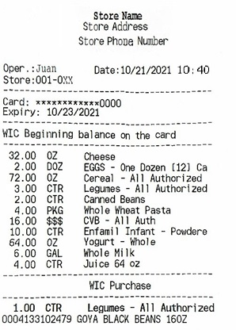
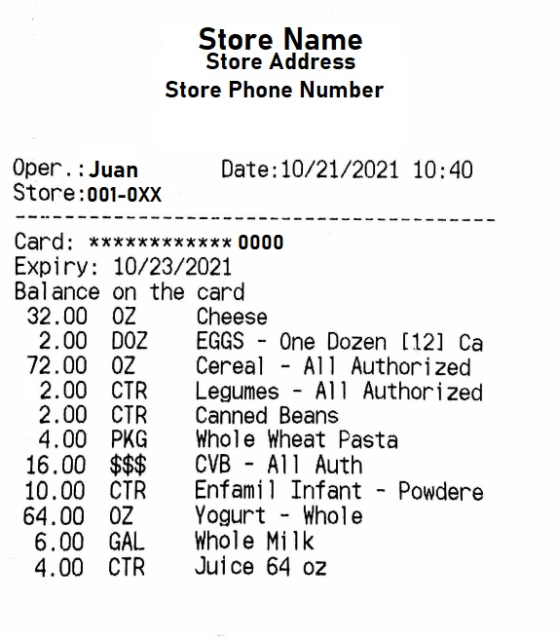

KeyPoints of eWIC Transaction Receipts
  *It is important to know the WIC Beginning Balance because if an item is not listed or the quantity is less than the WIC Cardholder wants to buy, they will not be able to do so.
  *The WIC Cardholder should always leave the store with what is listed here for the WIC Purchase.
  *The WIC Cardholders are encouraged to keep the Remaining Balance Receipt, so they know what is the remaining balance in their account.

Slide 7
Troubleshooting Resources
Problem/Question | The Contact for Assistance | Contact Information
Question regarding Vendor authorization | NJ WIC State Agency Vendor Unit | NJ.WICVendor@doh.nj.gov or 609-292-9560
Questions about how to become a NJ WIC authorized store location | Go to NJ WIC Vendor Portal | Interested in becoming a NJ WIC Authorized Vendor? Stores representatives must go to the NJ WIC Vendor Portal to submit an Initial Retailer Assessment form. Found Here: https://wic.nj.gov/VendorWeb/
Questions directly related to the eWIC certification process (including questions regarding Level 3 certifications) | NJ WIC State Agency Vendor Unit | NJ.WICVendor@doh.nj.gov or 609-292-9560 Level 3 Certification Team member: Erica Taylor Maudeline Jean-Pierre Juan Rocha (*English and Spanish) Ruby Lopez (*English and Spanish)

Slide 8
Troubleshooting Resources
Problem/Question | The Contact for Assistance | Contact Information
Questions regarding the Vendor POS Reimbursement Program, including application questions | NJ WIC State Agency Vendor Unit | NJ.WICVendor@doh.nj.gov or 609-292-9560 Level 3 Certification Team member: Erica Taylor Maudeline Jean-Pierre Juan Rocha (*English and Spanish) Ruby Lopez (*English and Spanish)
Questions about Stand-Beside terminal(s) | Solutran NJ WIC State Agency Vendor Unit If Solutran has not addressed your issue/question, contact the NJ WIC State Agency Vendor Unit | Retailcert@Solutran.com Solutran: Solutran Retail Support Helpline 1-866-730-7746 or NJ.WICVendor@doh.nj.gov or 609-292-9560

Slide 9
Troubleshooting Resources
Problem/Question | The Contact for Assistance | Contact Information
Questions about Integrated POS System(s) | POS provider NJ WIC State Agency Vendor Unit If your POS provider has not addressed your issue/question, contact the NJ WIC State Agency Vendor Unit | Vendor should contact their POS provider or NJ.WICVendor@doh.nj.gov or 609-292-9560
Questions or problems related to the APL or Food items that do not scan or requests for APL updates | NJ WIC State Agency APL team | NJ.WICVendor@doh.nj.gov or Use the NJ WICShopper app or 609-292-9560
A participant who is experiencing problems with their NJ eWIC card | NJ WIC Local Agency | New Jersey WIC operates offices across the state. To find your WIC Local Agency contact information, Click here: https://www.state.nj.us/health/fhs/wic/participants/find-wic/index.shtml

Slide 10
Troubleshooting Resources
Problem/Question | The Contact for Assistance | Contact Information
Questions or concerns about the MARL prices | NJ WIC State Agency Vendor Unit | NJ.WICVendor@doh.nj.gov or 609-292-9560
Questions about eWIC transactions | POS provider Solutran, if it is a stand beside terminal NJ WIC State Agency Vendor Unit, if it is about WIC related policies | Vendor should contact their POS Provider or Solutran: ebtservices@solutran.com Solutran Retail Support Helpline 1-866-730-7746 or NJ.WICVendor@doh.nj.gov or 609-292-9560
Problems with a rude WIC participant or a WIC participant that may be committing fraud | NJ WIC State Agency | WIC_Complaints@doh.nj.gov 609-292-9560 To File a complaint against a WIC participant: https://www.nj.gov/health/fhs/wic/vendors/

Slide 11
Troubleshooting Resources
Problem/Question | The Contact for Assistance | Contact Information
Requests for eWIC signage or training materials | NJ WIC State Agency Vendor Unit | NJ.WICVendor@doh.nj.gov or 609-292-9560
Requests for additional Vendor training | NJ WIC State Agency Vendor Unit | NJ.WICVendor@doh.nj.gov or 609-292-9560

